Slide 1


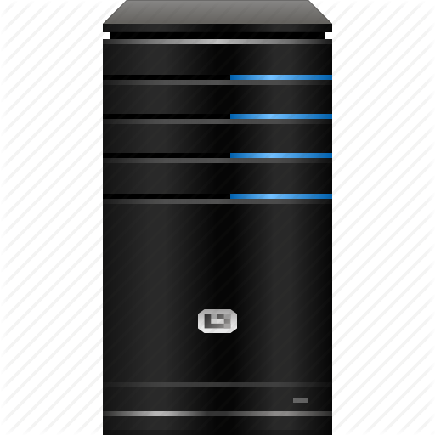


State Management
Cookies & Sessions
Java Web Dev Basics
SoftUni Team
Technical Trainers
Software University
http://softuni.bg

Slide 2




Table of Contents

Slide 3
Questions
sli.do #java-web

Slide 4
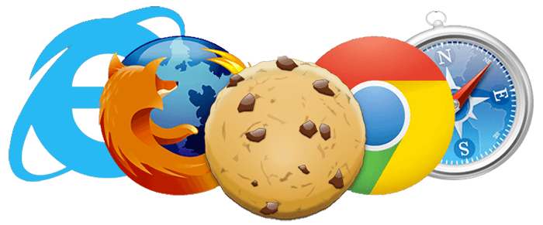
Cookies

Slide 5


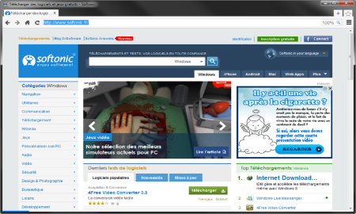



HTTP is Stateless
it doesn’t store information about the requests
Web Client
Web Application
GET
POST
GET
Not stored
Notes:
HTTP/2 protocol is also stateless, by design, as semantics remain unchanged in comparison to original HTTP. Header compression is stateful. One compression context and one decompression context are used for the entire connection. HPACK, Header Compression for HTTP/2, is a compression format especially crafted for HTTP/2 headers, and it is being specified in a separate internet draft. It doesn't change HTTP/2 itself, so it doesn't change the semantics.
Resource: https://stackoverflow.com/questions/36178447/is-http-2-a-stateless-protocol

Slide 6
What are Cookies?
A small piece of data that a web server sends to the user’s web browser
http://www.oracle.com/
Web Client
Web Application
GET www.example.bg HTTP/1.1
HTTP/1.1 200 OK Set-Cookie: lang=en
GET www.example.bg HTTP/1.1 Cookie: lang=en

Slide 7
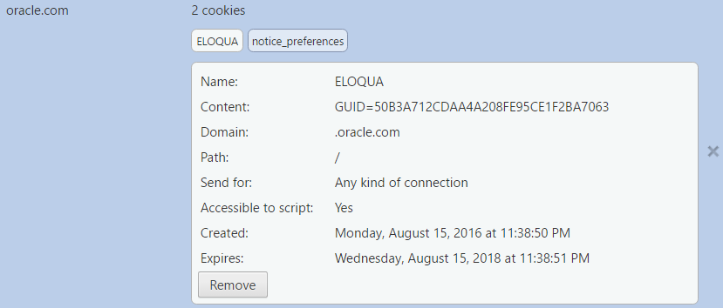
Cookie Example
Name
Value
Host
Is secured?
HTTP only
Created on
Expires on

Slide 8




Cookie Purpose
Cookie
Language settings
Preferences (Remember sign in)
Store
Session

Slide 9
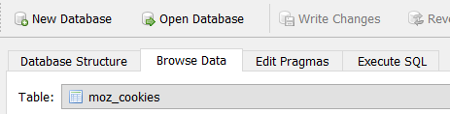
Examine your Cookies
Most cookies are stored in a RDBMS, usually SQLite
Download SQLite browser from here
In Mozilla cookies are located here:
Open the file with the sqlite browser
C:\Users\{username}\AppData\Roaming\Mozilla\Firefox\Profiles\2awcekaj.default\cookies.sqlite

Slide 10
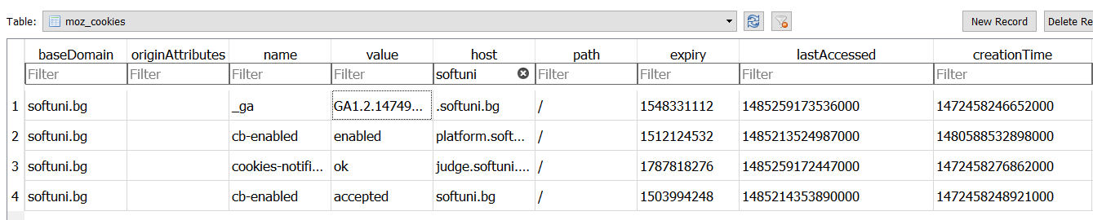
Examine your Cookies (Mozilla)
Name
Host
Created on
Value
Last accessed on

Slide 11

Third Party Cookies
Cookies stored by an external party
http://stackoverflow.com/
Web Application
Web Client
Cookie transfer
Cookie transfer
Third Party

Slide 12
Cookies
Live Demo

Slide 13

Sessions

Slide 14

What are Sessions?
A session is a way to store information to be used across multiple pages
/login
Web Application
Session
/home
user: Prakash
/products

Slide 15
Relation with Cookies
Session Store
sid 5 { uid: 101 }
sid 7 { uid: 102 }
Cookie {
name: sid value: 5
}
Validate
Req
Web Application
Session
Resp
Database
Cookie {
name: sid value: 7
}
Req
Get data
uid name 101 Prakash
102 Stamat
Resp
Create personal web page

Slide 16
Custom-made Session
Session.java
public class Session {
private long id;
private Map<String, String> pairs;
private Date createdOn;
private Date expiresOn;
}
Unique id
Key-value pairs
Creation date
Expiration date

Slide 17
Create your own Sessions
Live Demo

Slide 18


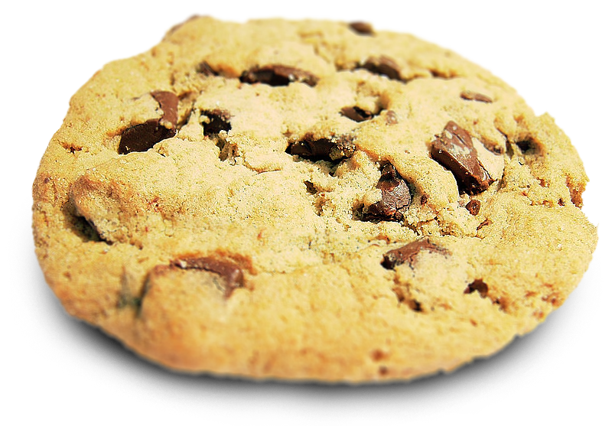
Summary
Cookies are:
client based stored information
created by web applications
sent back to the server, by the client
Sessions are:
server based information
used across multiple pages

Slide 19







Java Web Dev Basics – State Management
https://softuni.bg/courses/java-web-development-basics

Slide 20






SoftUni Diamond Partners

Slide 21






SoftUni Diamond Partners

Slide 22
License
This course (slides, examples, demos, videos, homework, etc.) is licensed under the "Creative Commons Attribution-NonCommercial-ShareAlike 4.0 International" license

Slide 23





Trainings @ Software University (SoftUni)
Software University – High-Quality Education, Profession and Job for Software Developers
softuni.bg
Software University Foundation
http://softuni.foundation/
Software University @ Facebook
facebook.com/SoftwareUniversity
Software University Forums
forum.softuni.bg

